Slide 1


Slide 2



MEET OUR SPEAKERS
Raj Tiwari Director of
Data Engineering and Business Analytics
Ankit Chaudhary Data Engineer
Orchestrate, build and scale Machine Learning and Business Intelligence solutions to scale our business.

Slide 3



CONTENTS
About Stanley Martin Homes
SMH Pricing Analytics Application
Redfin Data Extraction

Slide 4

ABOUT STANLEY MARTIN HOMES
1966
2017
May 2021
September 2021
Founded in Maryland Suburbs by Martin Alloy and Stanley Halle
Joined Daiwa House Group. A Fortune 500 company and one of the largest real estate and development companies in the world
Named National "Builder of the Year" by Builder Magazine.
Acquired Avex Homes and entered Florida offering homes in Tampa and Orlando.
Notes:
How do we achieve that?
Innovative design, National Expansion Strategy and Investing in Technology.
Stanley Martin has also changed tremendously. From a start-up with two employees, Stanley and Martin, the company has now grown to 820 team members. If you add-in Stanley Martin Custom Homes, First Heritage Mortgage, and First Excel Title, we are now over 1,000 team members. From one neighborhood in Prince Georges County, Maryland, we have now grown to 13 homebuilding divisions in 7 states.

Slide 5




Our Companies
Top 100 largest mortgage companies in the country.
At Stanley Martin, we design and build homes people love at a price they can afford
Notes:
Let us see how we have utilized Data and Analytics for our Homebuilding industry.

Slide 6
01
How to be aware of competitor pricing
around our products.
02
Be in sync with
the current pricing trends.
03
Leverage data to correctly price our products.
Problem

Slide 7
SMH PRICING ANALYTICS APPLICATION
Notes:
Solution

Slide 8
Benchmark pricing of internal products with competitors.
Goal
Analyze data sourced from Zonda(Housing Market Data Aggregator) and Internal sources.

Slide 9


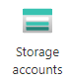

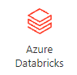
Process Flow and Components
SMH Projects
(SQL Server DB)
Process + Distance Calculation
Zonda Projects
(Looker)
Azure Storage
Azure App Service
Redfin Data
(Stored in Azure)
NYC Data Science Academy

Slide 10
Application Walkthrough

Slide 11
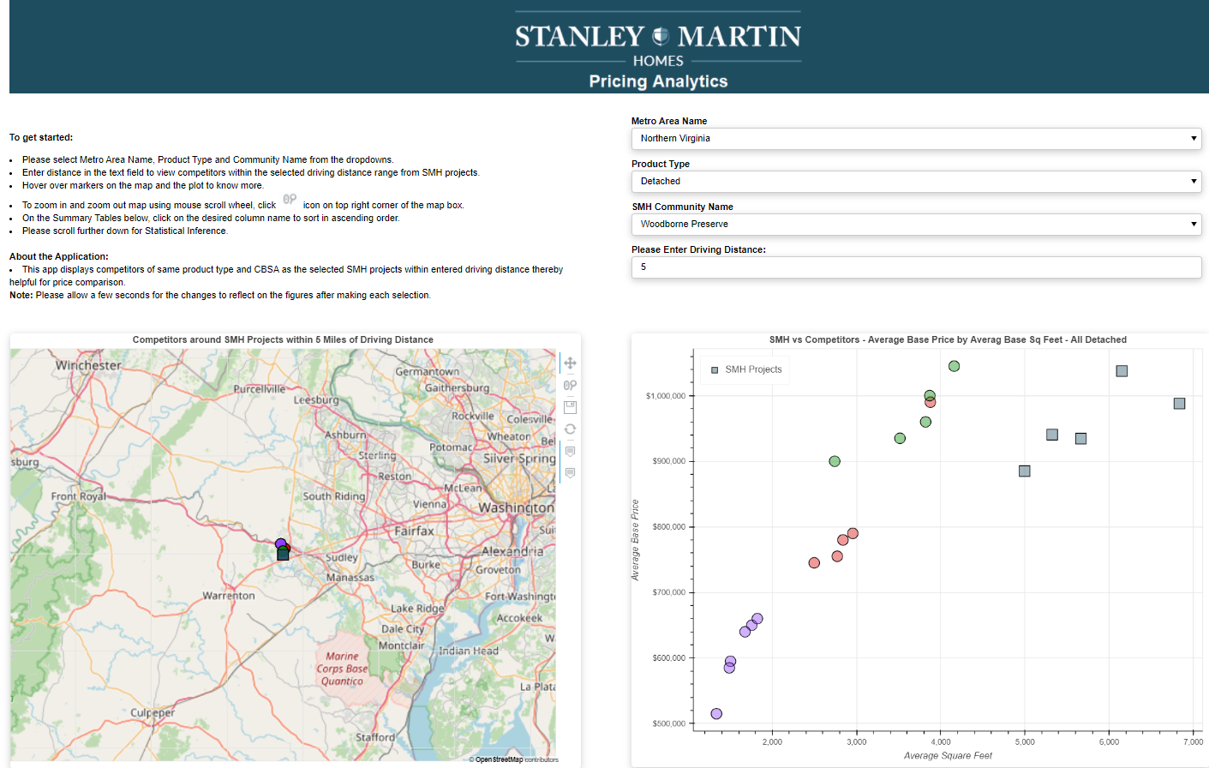
Current Layout
Zonda
MLS
Recreate
NYC Data Science Academy
Notes:
Application Demo

Slide 12
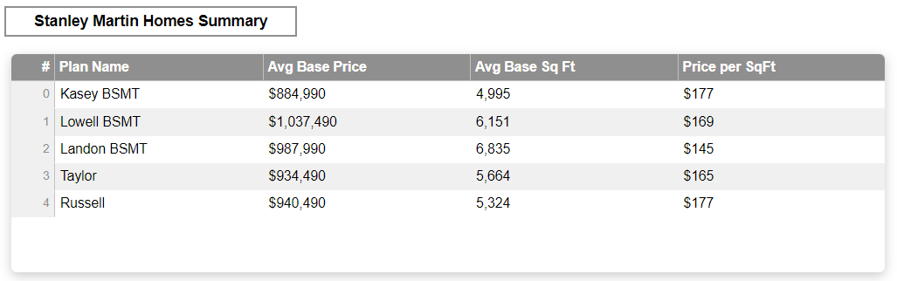
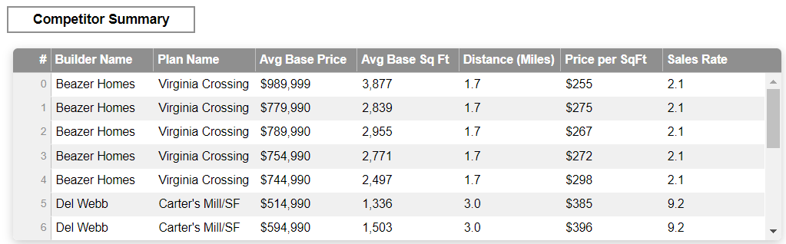

Slide 13
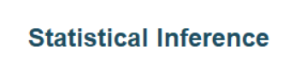
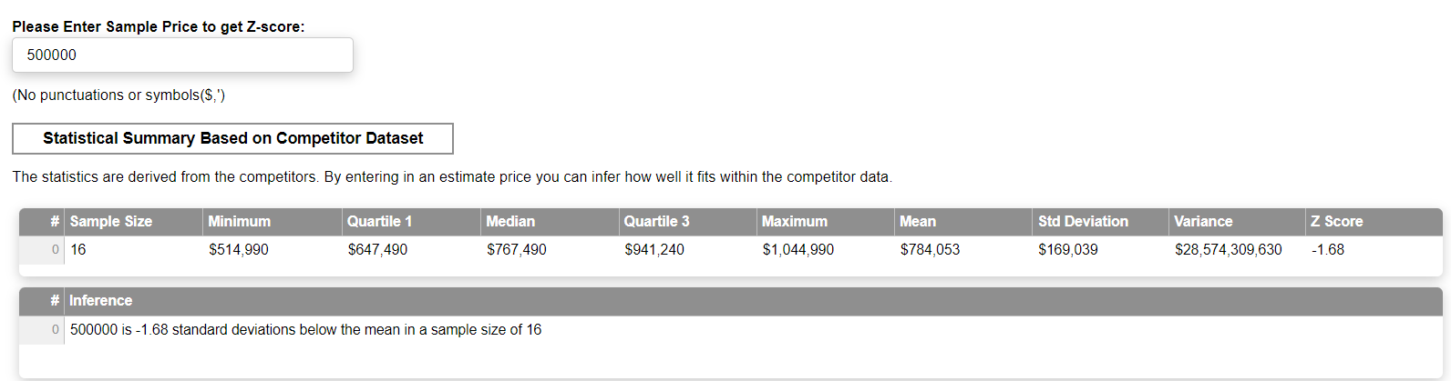

Slide 14
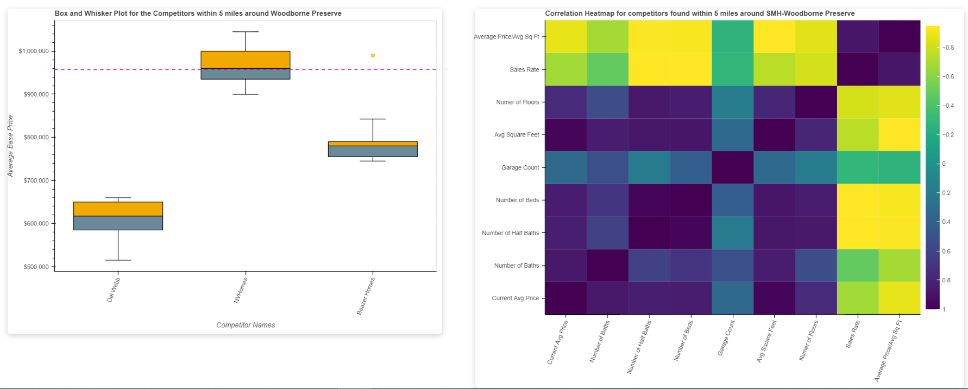

Slide 15
Tools Used
Python(pandas, numpy, bokeh, requests, colorcet, azure-storage-blob, pyproj)
GitHub
Databricks
Azure Blob Storage
Azure App Service
Azure App Authorization
MS SQL Server
Git Bash, Power Shell

Slide 16
Business Outcome/Value
A quick reference tool to get insights on the competitive pricing aiding quicker research.
Increased efficiency by over 35%.

Slide 17
Phase II
Develop pipeline to ingest and integrate MLS Data into existing structure of the application. Provide EDA, Hypothesis testing of feature set.
Bridge MLS Data with existing components to provide wholistic price comparison – SMH vs. Competitors vs. Resale Listings (MLS)
Affordability Index and Price Threshold testing.
Further enrich data to include crime rates, school ratings etc.
Feature engineering to determine which features should be included(Text Analysis etc.)
Regression to support prediction of price based on feature set.
Perform Time Series Forecast for Pricing (e.g., Arima).

Slide 18
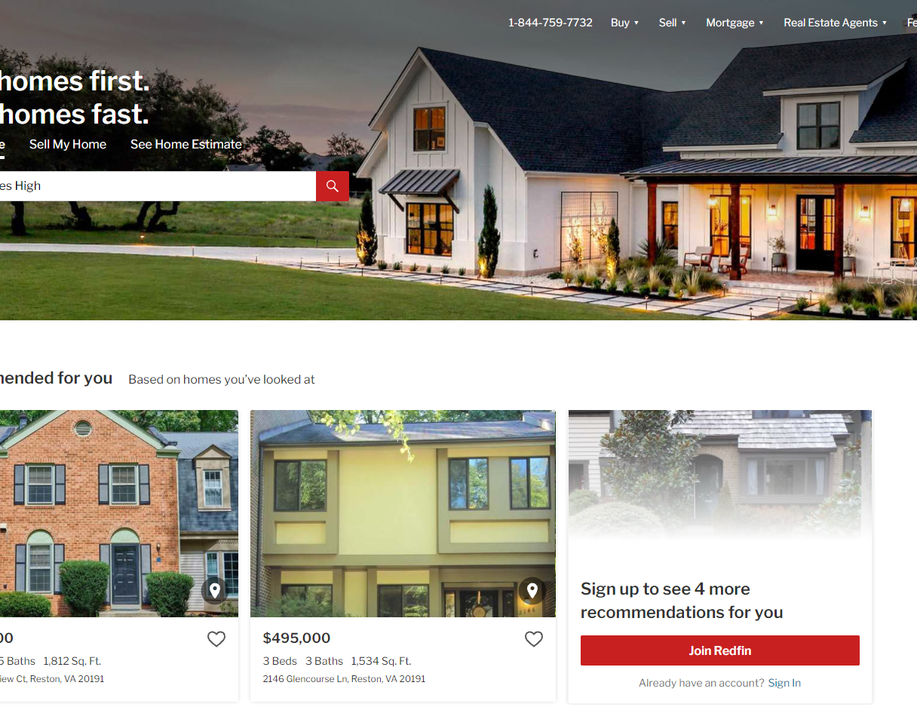
Redfin – NYC Data Science Project
A premier MLS listing search engine.
Extract active listings and closings data from Redfin.
Explore data extraction options using either a lookup on either neighborhood school boundary or Zip Code (provided by Stanley Martin).
Pricing analytics to include hypothesis testing, correlation matrix to support progression towards prediction and/or recommendation of pricing to Sales and Leadership for existing and new SMH projects.

Slide 19
What would we request from you?
Scraping and gathering Redfin data.
Integrate MLS data to the current application
Progressing towards ML based pricing optimization.
Home Facts
MLS#
Price Insights
Text
Public Facts
Schools
MLS Tab
Feature Engineering
Suggestive Pricing
Text Encoding
Example: https://www.redfin.com/VA/Reston/1657-Parkcrest-Cir-20190/unit-100/home/9248323

Slide 20









What the students can gain from the project?
Hands-on industrial experience – Web Scraping and Data Engineering for a real-world application.
Holistic experience on integrating new data pipeline into existing Data Solutions.
Exposure to industrial tools like Databricks, Azure, GitHub etc.
Post Project opportunities to further insights with ML. In fact, we will be expanding the team after the project.

Slide 21
Thank You

Slide 22


Slide 23
Appendix

Slide 24
SMH MARKET TRACKER

Slide 25
Create an interactive application to display Trended Building Permits, Market and Economic Indicators.
Goal
Aggregate and Engineer data from over 3000 API endpoints

Slide 26



PROCESS FLOW AND COMPONENTS
Building Permits Extract
Source: US Census
Azure Storage
Azure App Service
3,000+ APIs
Fred Indicators
Source: Federal Reserve

Slide 27
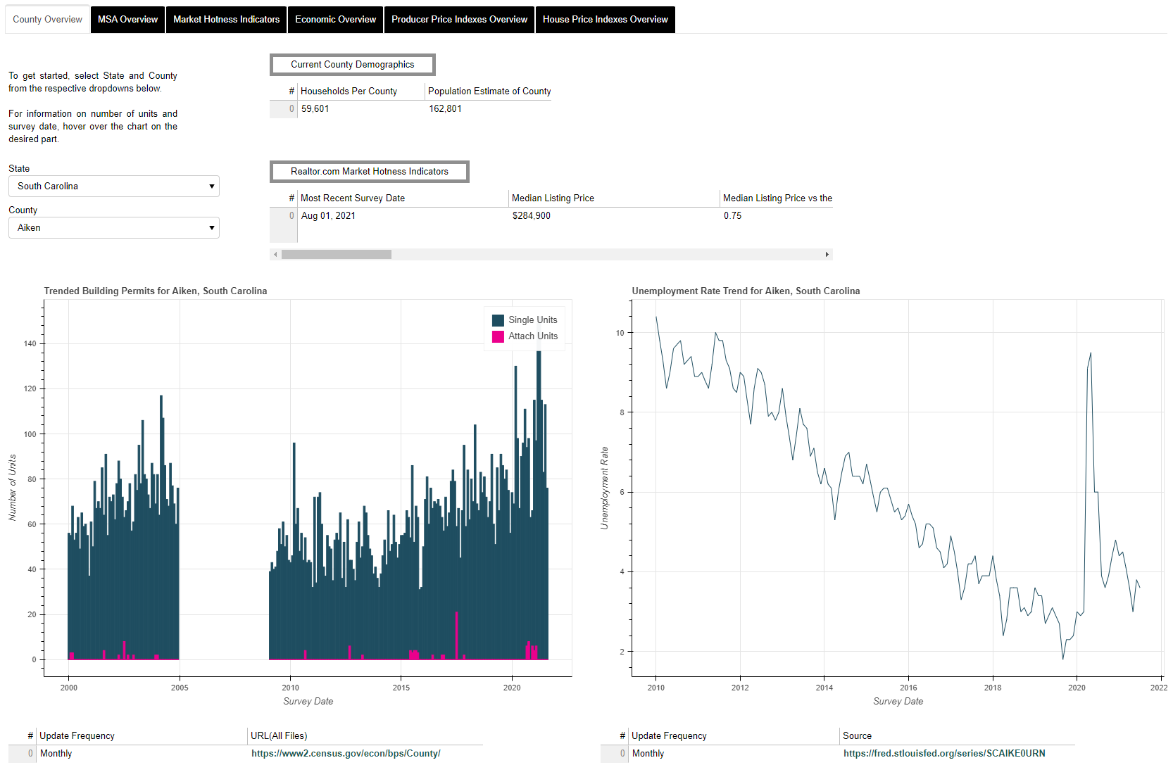

Slide 28
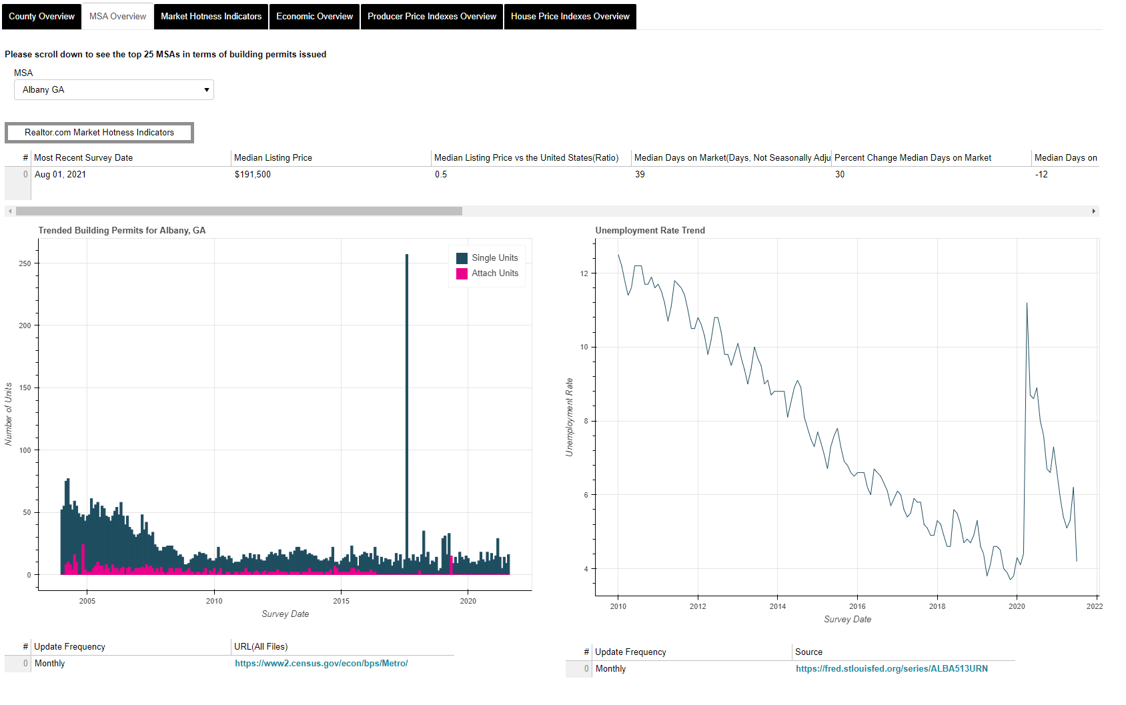

Slide 29
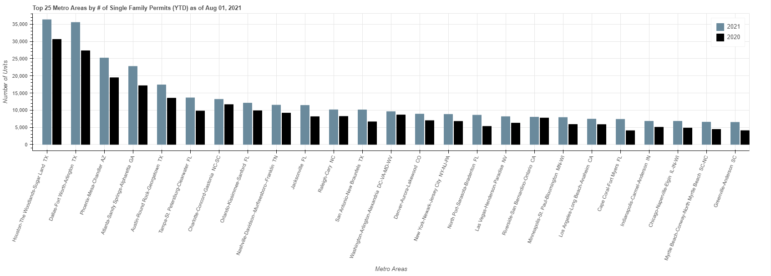

Slide 30
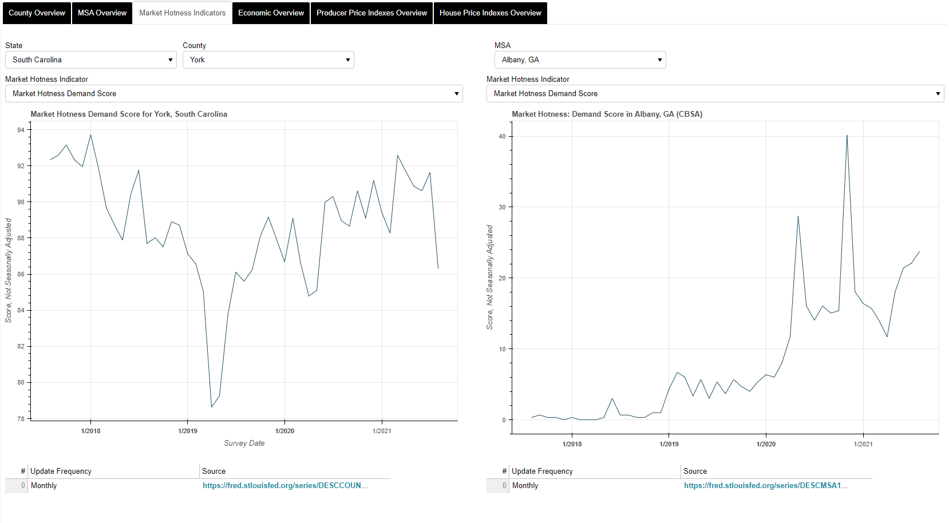

Slide 31
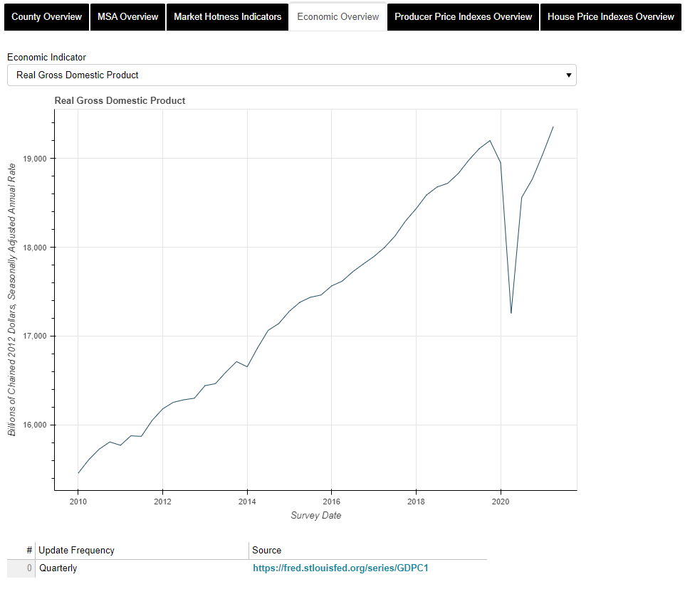

Slide 32
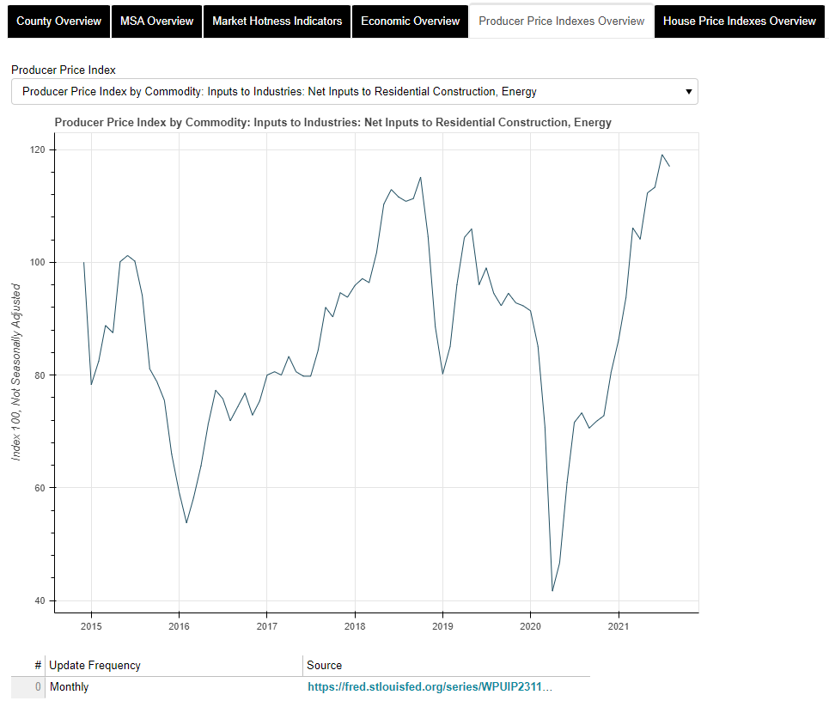

Slide 33
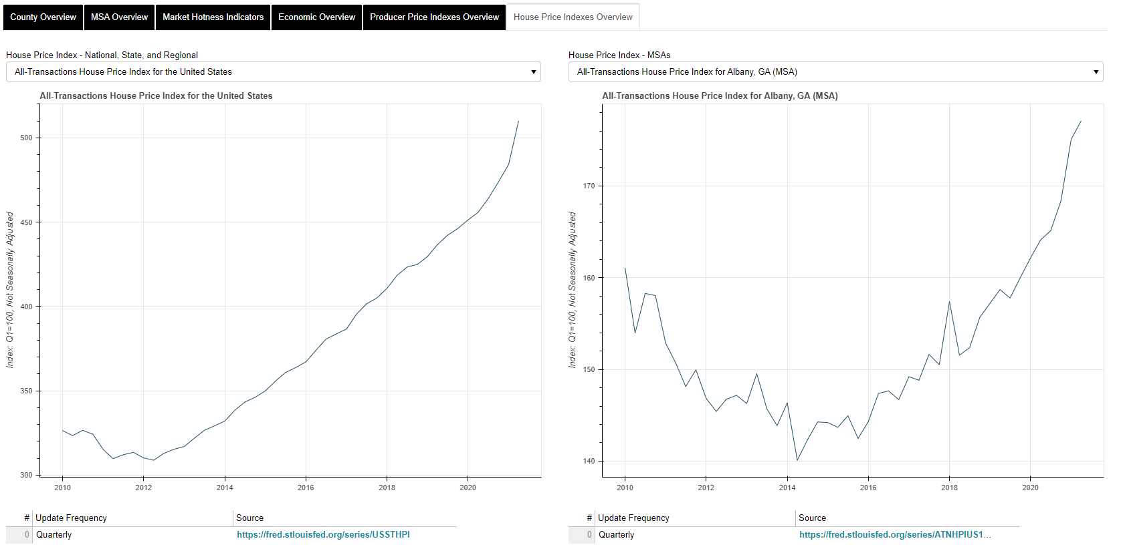

Slide 34
Python(pandas, bokeh, requests, fredapi, xlrd)
GitHub CI/CD
Tools Used
Databricks
Azure Blob Storage
Azure App Service
Azure App Authorization
MS SQL Server
Git Bash, Power Shell
34

Slide 35
Business Outcome/Value
The resulting automated reporting increased efficiency of the various teams to draw insights by over 40%
35

